Slide 1
Salesforce with ReactJs for faster Visualforce
What ReactJs is? How we can use to speedup Visualforce rendering?
Arun Palhora
Salesforce Technical Architect at Appirio
apalhora@appirio.com

Slide 2
About me
Salesforce Technical Architect at Appirio
Certified Salesforce Administrator
Certified Salesforce Developer
Certified Salesforce Advanced Developer
Certified Salesforce Sales Cloud Consultant

Slide 3
Agenda
1
Introduction to ReactJs What is ReactJs, why to use it while building apps?
Demo of ReactJs Simple demo of using ReactJs in HTML page
ReactJs in Visualforce Pages Why we should use in Visualforce pages
Demo of ReactJs in Visualforce Page Step by step build a VF page using ReactJs
Next steps and Resources Link to ReactJs Docs and Github link of todays demo
Q&A
2
3
4
5
6

Slide 4
1. Introduction to ReactJs
What is ReactJs, why to use it while building apps?

Slide 5
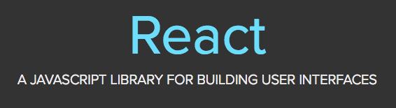
What is ReactJs
React is a JavaScript library for creating user interfaces by Facebook and Instagram

Slide 6
Model View Controller
Controller
View
Model

Slide 7
React is considered as the V (View) in MVC
Controller
View
Model

Slide 8
Why ReactJs
Build large applications with data that changes over time
Application Header
List of Deals
Deal 1
Deal 2
Deal 3
….
….
….
….
Detail 1
Detail 2
Detail 3
Detail 4
Name | Date | Quantity | Price (USD)
Product 1 | 10/01/2016 | 1000 | 22.97
Product 2 | 10/01/2016 | 20 | 349.99
Product 1 | 10/01/2016 | 110 | 10.00
… | … | … | …

Slide 9
But during a View update, the entire DOM tree will be updated, which might not be needed. Like changing from Deal 1 to Deal 2
Application Header
List of Deals
Deal 1
Deal 2
Deal 3
….
….
….
….
Detail 1
Detail 2
Detail 3 - 2
Detail 4
Name | Date | Quantity | Price (USD)
Product 1 | 10/20/2016 | 800 | 22.97
Product 2 | 10/01/2016 | 20 | 349.99
Product 1 | 10/01/2016 | 150 | 9.80
… | … | … | …

Slide 10
Changing to ‘Deal 2’ mainly updates highlighted sections of page
Application Header
List of Deals
Deal 1
Deal 2
Deal 3
….
….
….
….
Detail 1
Detail 2
Detail 3 - 2
Detail 4
Name | Date | Quantity | Price (USD)
Product 1 | 10/20/2016 | 800 | 22.97
Product 2 | 10/01/2016 | 20 | 349.99
Product 1 | 10/01/2016 | 150 | 9.80
… | … | … | …

Slide 11
Build Composable Components
Application Header
List of Deals
Deal 1
Deal 2
Deal 3
….
….
….
….
Detail 1
Detail 2
Detail 3
Detail 4
Name | Date | Quantity | Price (USD)
Product 1 | 10/01/2016 | 1000 | 22.97
Product 2 | 10/01/2016 | 20 | 349.99
Product 1 | 10/01/2016 | 110 | 10.00
… | … | … | …

Slide 12
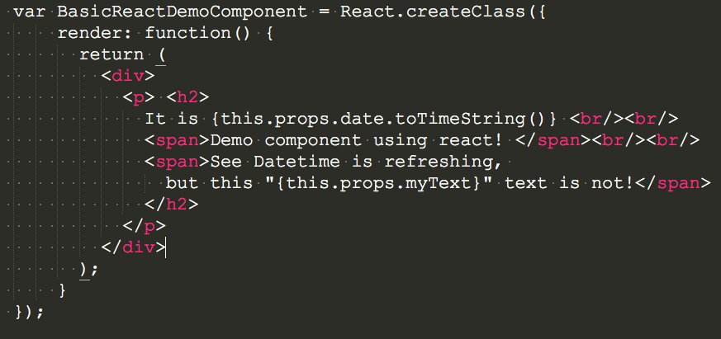
Simple & Declarative

Slide 13
ReactJs Jargons
JSX
JSX lets you create JavaScript objects using HTML syntax
Without JSX
With JSX

Slide 14
‘props’ for Properties
Data passed from Parent Component to Child Components. ‘props’ are immutable
‘state’
Data can be updated on component and is know as mutable state.
component specifications
render()
getInitialState()
getDefaultProps()
propTypes
mixins
statics

Slide 15
Lifecyle methods
componentWillMount()
componentDidMount()
componentWillReceiveProps()
shouldComponentUpdate()
componentWillUpdate()
componentDidUpdate()
componentWillUnmount()

Slide 16
2. Demo of ReactJs
Simple demo of using ReactJs in HTML page

Slide 17
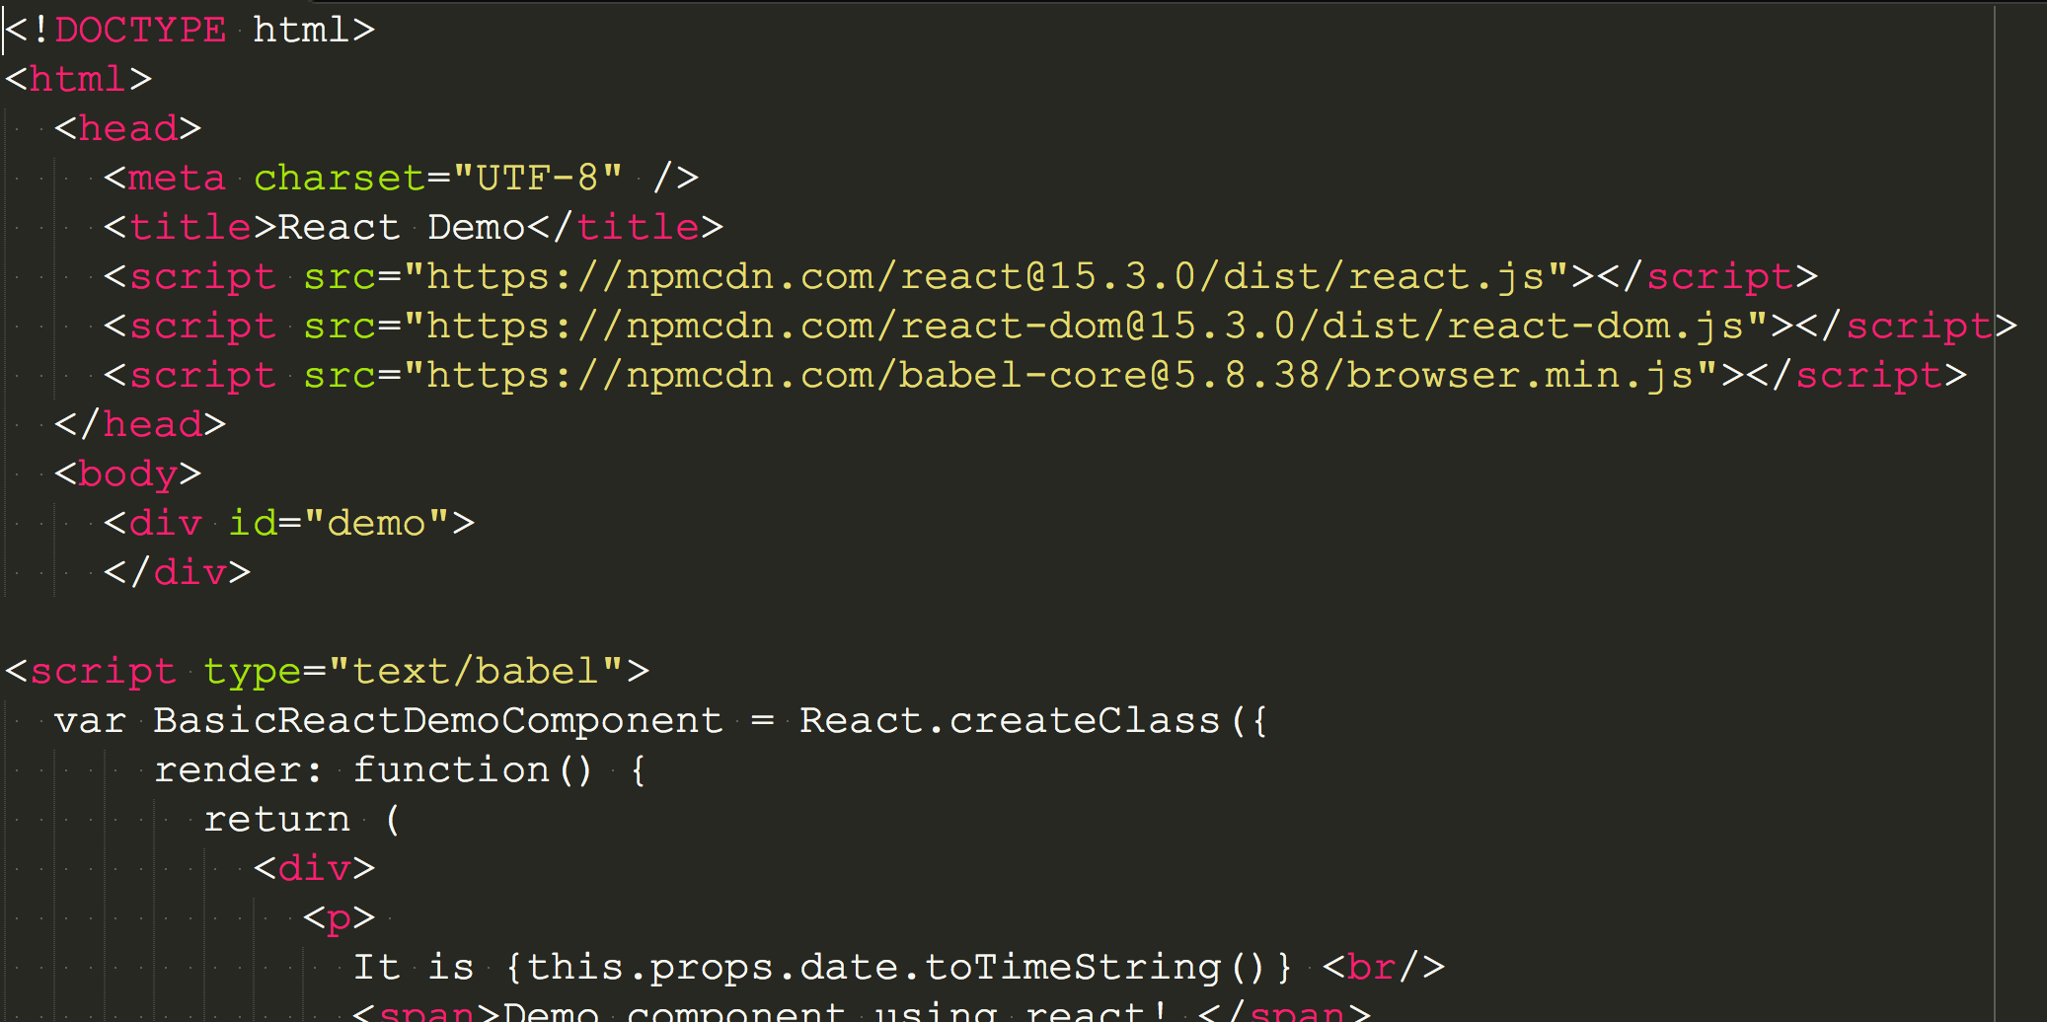

Slide 18
DOM Tree Comparison
body
div
div
div
div
div
p
div
table
span
span
Updated Time
tr
tr
tr

Slide 19
DOM Tree Comparison
body
div
div
div
div
div
p
div
table
span
span
Updated Time
tr
tr
tr

Slide 20
3. ReactJs in Visualforce Pages
Why we should use in Visualforce pages

Slide 21
Use ReactJs in Visualforce pages
Page has to be highly responsive
Page has to display a lot of data
Page has a lot of changing data and is super interactive
Bypass View State size of VF page
To have better control of components and state when and how an element is updated

Slide 22
4. Demo of ReactJs in Visualforce Page
Step by Step build a VF page using ReactJs

Slide 23
5. Next steps and Resources
Link to ReactJs Docs and Github link of todays demo

Slide 24
ReactJs in VisualForce pages
ReactJs Docs
https://facebook.github.io/react/index.html
https://facebook.github.io/react/docs/tutorial.html
GitHub link of Todays Demos
https://github.com/arunpalhora/DF_2016
http://bit.ly/2crTTDQ

Slide 25
7. Q&A

Slide 26
Thank you

